Slide 1
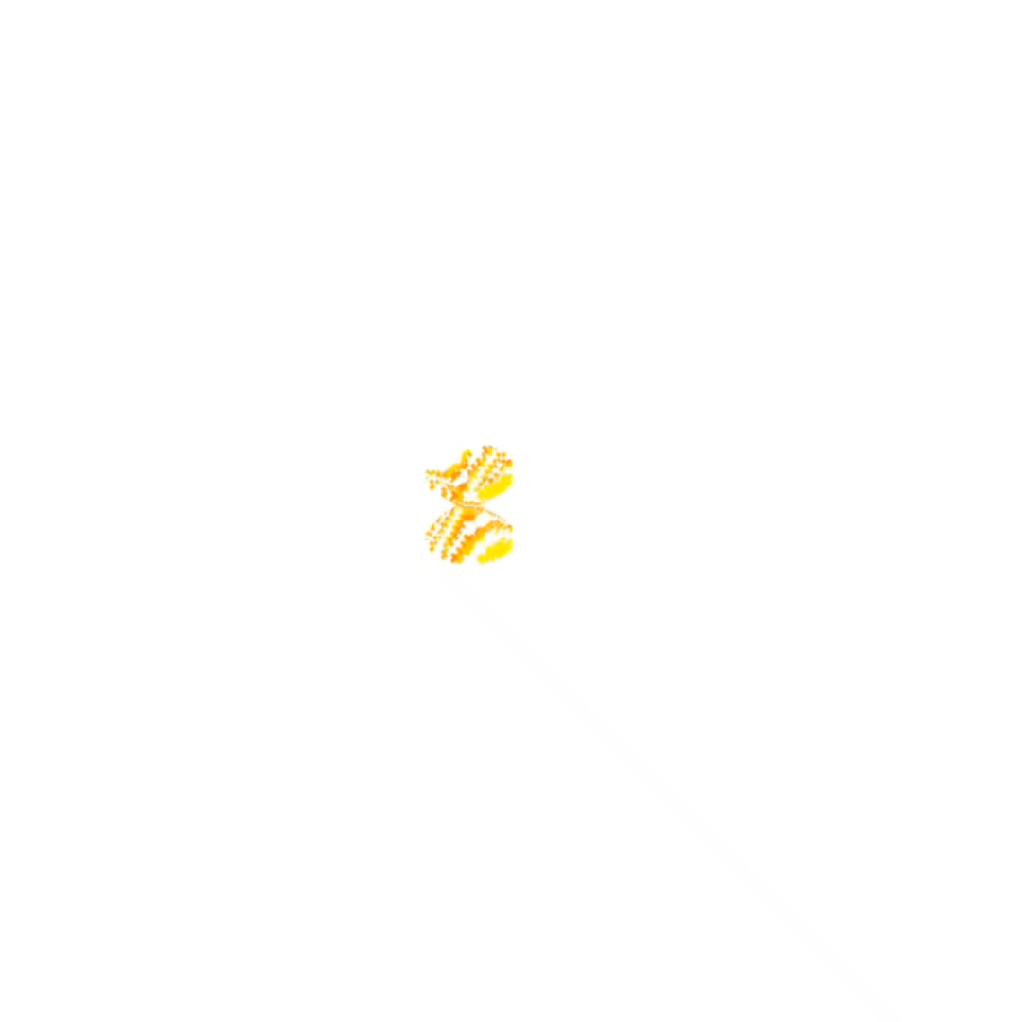
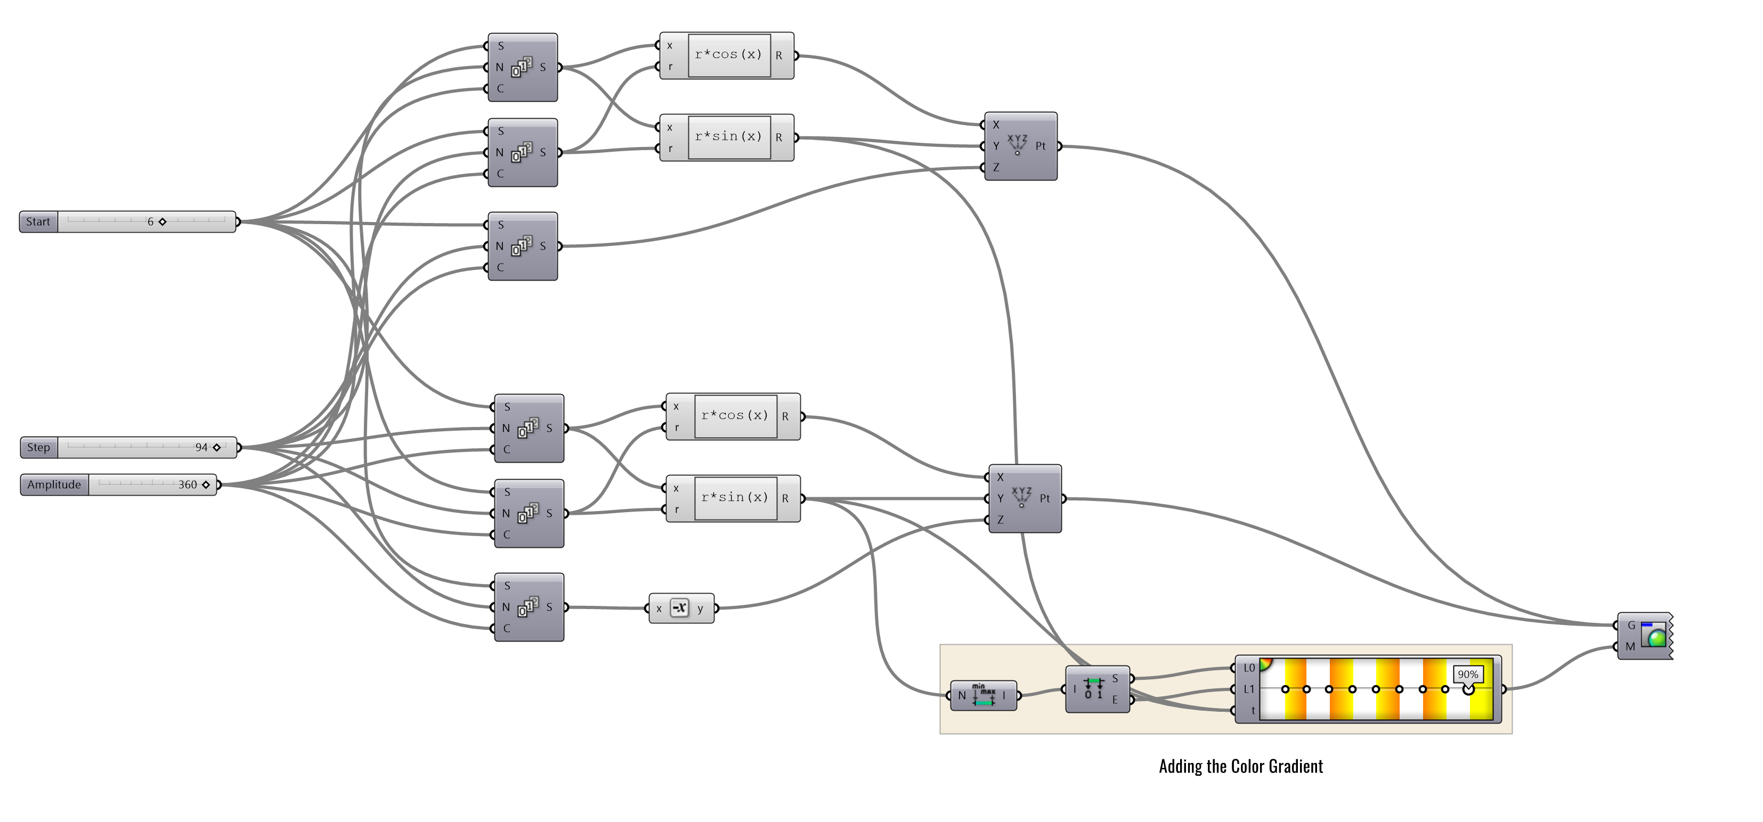
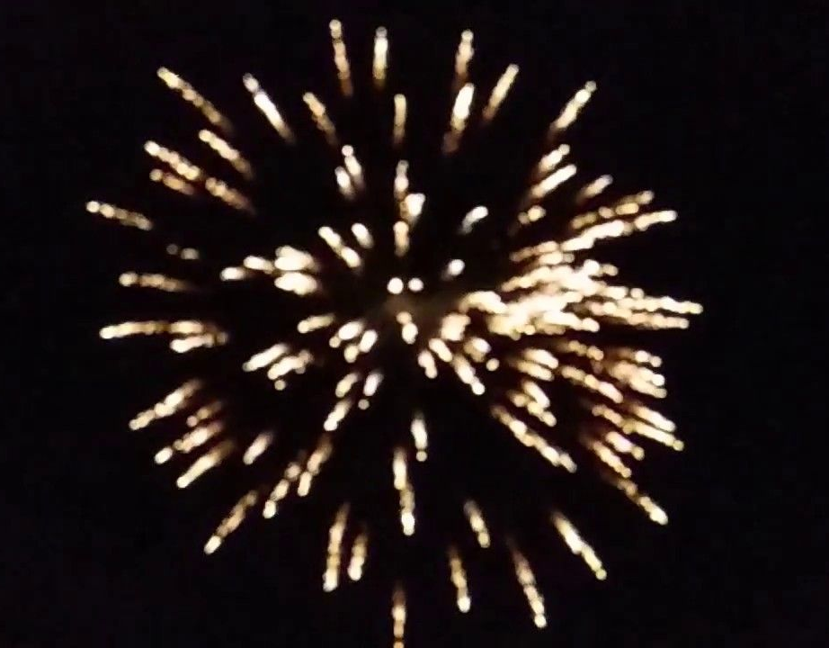

Workout [3] - Point Manipulation
Grasshopper Script
Mathematical Expression
Generation of Points
Preview
Generating a resembling Color Scheme
Inspiration : Cracker

Slide 2
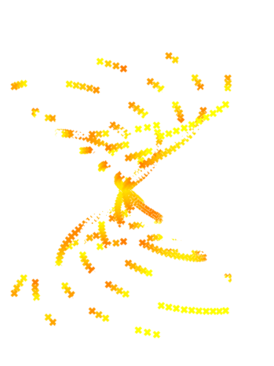
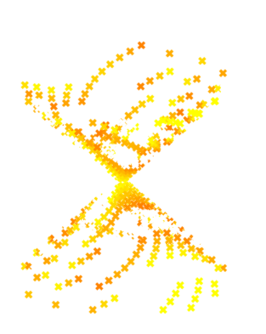
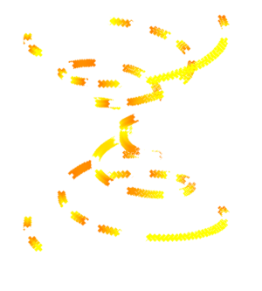
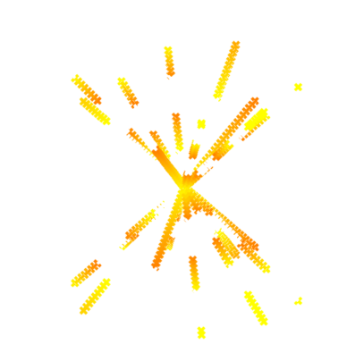

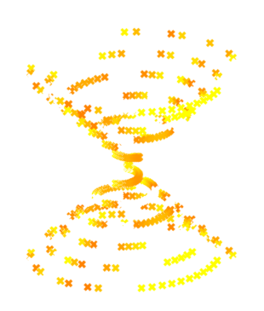
Workout [3] - Point Manipulation
Grasshopper Script
Mathematical Expression
Generation of Points
1
2
3
Preview
Generating a resembling Color Scheme
Inspiration : Cracker
4
5
6

